Slide 1
Project Management
Buffalo State Data Science and Analytics
Managing a Project from A-Z

Slide 2
Managing a Project from A-Z
Feasibility Study
Project Risk
Project Constraints
Business Case Document
Project Initiation
Work Breakdown Structure (WBS)
Key Performance Indicators (KPIs) and Key Responsibility Areas (KRAs)
Sprint Burndown Chart
Project Charter
Sprint Burndown Chart
RACI Matrix

Slide 3
Managing a Project from A-Z
Feasibility Study
Project Risk
Project Constraints
Business Case Document
Project Initiation
Work Breakdown Structure (WBS)
Key Performance Indicators (KPIs) and Key Responsibility Areas (KRAs)
Sprint Burndown Chart
Project Charter
Sprint Burndown Chart
RACI Matrix

Slide 4
What is a Feasibility Study?
It is an assessment of the practicality of a proposed plan or method.
You would perform the Feasibility Study during a project life-cycle right after the business case.
One might ask questions such as:
Do we have the technology to undertake this project?
Do we have the necessary human resources to undertake this project?
Will we achieve the necessary return on investment?
Can we meet the requested deadline?
These studies can be different project to project

Slide 5
Why are Feasibility Studies Important?
Central idea of all feasibility studies are to address a deep question “Is the a viable idea to proceed with?”
This study determines the factors that will make the business opportunity or project a success
It is an objective analysis
A feasibility report is produced at the end of the study that presents the findings and recommendations
The feasibility study can tell you how to strategically improve a product or service On-Scope, On-Budget, and On-Time

Slide 6
General Framework: Business Projects
Conduct a preliminary analysis
Prepare a projected income statement
Conduct a market strategy
Plan business organization and operations
Prepare an opening day balance sheet
Review and analyze all data
Make GO or NO-GO decision

Slide 7
Best Practices: Business Projects
Conduct a preliminary analysis
Prepare a projected income statement
Conduct a market strategy
Plan business organization and operations
Prepare an opening day balance sheet
Review and analyze all data
Make GO or NO-GO decision

Slide 8
General Framework: Five Point Feasibility Assessment
Main goal is to ask “Can the challenges in each category be managed?”
Technical: Do we have the necessary technical know-how in the team to achieve the technical goals of the project On-Scope, On-Budget, and On-Time?
Economic / Financial: Do we have enough financial freedom to capital bare the up front capital and operational expenditure to take on this project?
Legal: Is the scope of the project lawful and does the deliverables fall within the organization/group/team by-laws to move forward?
Operational: Do we have the necessary facilities, equipment, and man-power to achieve the deliverables of the project On-Scope, On-Budget, and On-Time?
Scheduling: Can we complete the project within the sponsor requested deadline?

Slide 9
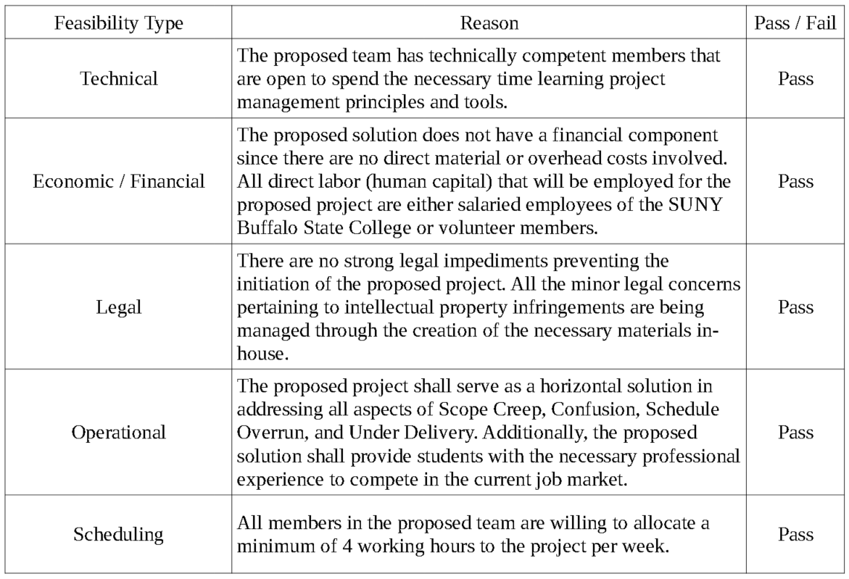
Example: Five Point Feasibility Assessment

Slide 10
Template Format: Feasibility Report
Executive Summary
Description of Project or Service
Technology Considerations
Product or Service Market Place
Marketing Strategy
Organization and Staffing
Schedule
Financial Projections
Findings and Recommendations

Slide 11
References
How to Conduct a Feasibility Study - Project Management Training
https://www.youtube.com/watch?v=WI6_snOjlm0
Technical Feasibility
https://www.youtube.com/watch?v=6e5Tn8nOFuk
Feasibility Study
https://www.youtube.com/watch?v=5ATiyRVclhc

Slide 12
Managing a Project from A-Z
Feasibility Study
Project Risk
Project Constraints
Business Case Document
Project Initiation
Work Breakdown Structure (WBS)
Key Performance Indicators (KPIs) and Key Responsibility Areas (KRAs)
Sprint Burndown Chart
Project Charter
Sprint Burndown Chart
RACI Matrix

Slide 13
What is Project Risk?
Risk is a potential event that affects the project.
It can have a positive or negative effect on the project outcome.
Issues (i.e. things that already happened or are happening) are NOT a Risk.
They come from:
Project plan (possibly the scope, cost or time)
Project Management Plan (scope, cost, time)
Stakeholders
Project documents
Enterprise environment
Organizational process assets
Government mandates
Natural disaster

Slide 14
Why is Project Risk Important?
Risk may have a positive or negative effect on the outcome of the project. Managing risk will assure a successful outcome of the project.

Slide 15
A Good Starting Point
When determining potential risks, a good place to start is to look for possible events that have not necessarily been accounted for in the project design.

Slide 16
Project Risk in the Context of Project Management
When designing a project using Project Management (PM) tools, risk is a consideration that will help in many ways.
Risk Management will:
Help understand the project
Reduce uncertainties that jeopardize project metrics
Consulting stakeholders, for example, may help mitigate it.

Slide 17
Examples of Risk
Example 1:
A company puts out a product. A potential risk could be that the demand for this product is beyond the company’s infrastructure capacity. This may affect the company negatively.
Example 2:
Consider Project LaCEM. A lack of familiarity with project management principles by the team members can negatively affect the timeline because it may take them longer to complete tasks while also learning about project management.

Slide 18
What is a Risk Register?
It is a documented result of the qualitative and quantitative risk analysis and risk response planning. It includes:
Description
Category
Cause
Probability
Impact
Proposed Responses
Owner of Risk
Status
Risk Registrar may also be called a Risk Log.

Slide 19
An Example Risk Registrar
The table below can be used as a template to create a Risk Register.
Project LaCEM Risk Register could be as follows:
Description | Category | Cause | Probability | Impact | Proposed Responses | Owner of Risk | Status
Lack of resources to complete project | Resources | No budget | 40% | Students will not have the PM resources benefit | Convince participants of LaCEM value | All | Under control

Slide 20
References:
https://www.youtube.com/watch?v=nbhLDJkNnzY

Slide 21
Managing a Project from A-Z
Feasibility Study
Project Risk
Project Constraints
Business Case Document
Project Initiation
Work Breakdown Structure (WBS)
Key Performance Indicators (KPIs) and Key Responsibility Areas (KRAs)
Sprint Burndown Chart
Project Charter
Sprint Burndown Chart
RACI Matrix

Slide 22
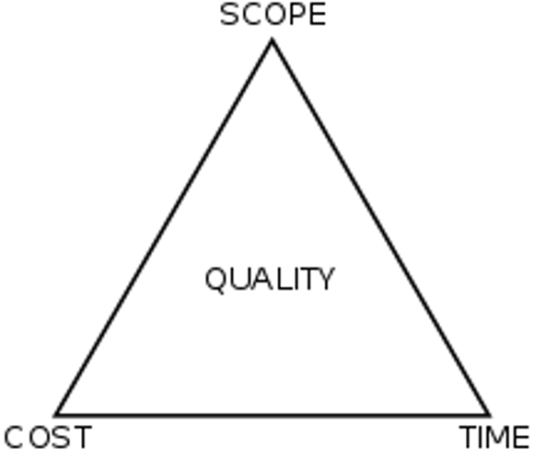
What is a Project Constraint?
Project Constraints (PCs) are limits to project decisions.
Constraints can include:
Scope
Time
Cost

Slide 23
Why are Project Constrains Important?
Projects are limited and bounded by functional and real issues. In PM the set of these limits is called Project Constraints. PC are important because they determine whether the project will be completed as expected (or carried out at all). The project may have to be modified after looking at the project constraints.

Slide 24
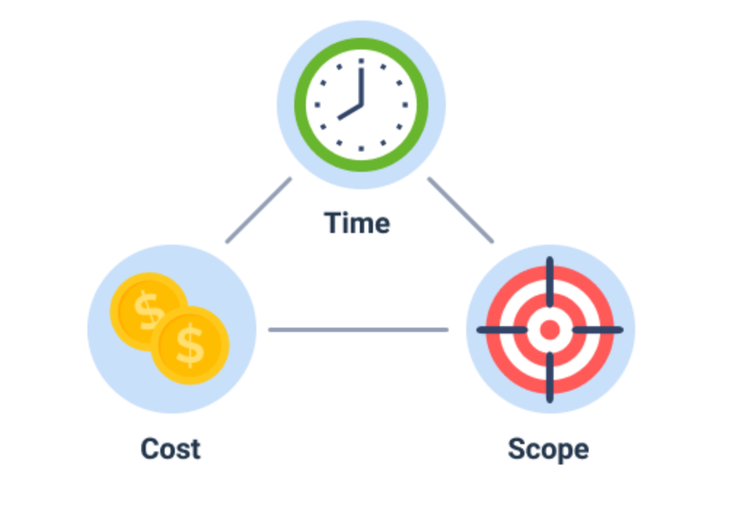
A Good Starting Point
Project Constraints should be on the radar from the start.
A common place to start is to look at what is commonly referred as the triple constraint: scope, budget and schedule.
To identify constraints, we look at limits that need to be placed on the triple constraints.

Slide 25
Put it into the context of Project Management
Constraints are known limits to the planning and implementation of a project.
Constraints require planning iterations, corrective actions, choice among different project constraints.
The decisions when dealing with constraints must be made by the sponsor, not the project manager since they have no autonomy.
A well know concept is the Triple Constraint: Cost-Scope-Time since these are important and always present constraints.

Slide 26
Example of Project Constraints
A company has chosen a specific technology. Constraints in the implementation can be:
Schedule: it must be ready before a certain product launch date
Budget: the cost must justify the choice
Scope: it must address the problems that motivated the choice of technology
Quality, Resources and Risk are sometimes called dependent constraints

Slide 27
Example of Project Constraints
Project LaCEM’s contraints could be:
Budget: Since this project was undertaken by a team of faculty and staff without a direct monetary incentive, the budget can be considered to be the human resource available. The job had to be done with the limit of the volunteers time.
Time/schedule: To have an impact, we needed LaCEM to be ready before the end of the Summer.
Scope: LaCEM addressed the need for better communication and expectations for students and partners involved in the Professional Lab projects.

Slide 28
References
https://www.youtube.com/watch?v=z4hKX7m_q-4

Slide 29
Managing a Project from A-Z
Feasibility Study
Project Risk
Project Constraints
Business Case Document
Project Initiation
Work Breakdown Structure (WBS)
Key Performance Indicators (KPIs) and Key Responsibility Areas (KRAs)
Sprint Burndown Chart
Project Charter
Sprint Burndown Chart
RACI Matrix

Slide 30
What is a Business Case?
The business case is a document that gives justification for the project.
Business Case helps us define the project itself.
What changes will the project bring.
The Business Case shows expected benefits.
Business Case lists requirements, what the problem is, establishing the scope.
Agreement is needed from all the involved people.
Business Case is the move from the initial state to the implementation stage in the life cycle.

Slide 31
Why is a Business Case important?
Without a BC a project may not be approved, and if approved, it may not be supported by the people involved.
A BC will place issues in context and in contrast within the options (including not doing the project).

Slide 32
A Template to Explore
A Business Case should include:
Strategic context: rationale for change in the internal or external environment.
Objectives: they must be measurable and clear.
Required analysis and recommendations:
Reasons or problems; Requirements;
Scope; Options; Benefits; Expected Resources;
Timescale; Costs; Risks.
How the project fits in the organizational structure.

Slide 33
Who Makes the Business Case?
In a Project Management life cycle, the following individuals and groups play a role in the creation and use of the BC:
Project sponsor (senior management) owns the business case.
The project manager writes the business case and schedules its steps.
Lastly, the users that will implement the project are also affected by the BC and are the third party involved.

Slide 34
An Example Business Case
BC may be needed to change software within an organization, say from Power BI to Tableau.
Exploring and writing each of the items explained in the slides above is a nice exercise for someone interested in this or a similar software change.

Slide 35
An Example Business Case
The business case for LaCEM was created by the project sponsor (the chair of the DSA MS program). It included the reasons why LaCEM is needed and the goals to achieve:
To improve communication within all future projects under DSA690 by the use of SOPs.
To help setup SMART goals for all projects.
To automate as many project activities as possible to minimize unexpected circumstantial delays.
To adopt the mentality “under promise and over deliver” on all aspects of all future projects.
To standardize a template project infrastructure for all projects.
To provide students a high quality project experience through the use of project management.

Slide 36
References:
https://www.youtube.com/watch?v=OJM9UGohVGQ

Slide 37
Managing a Project from A-Z
Feasibility Study
Project Risk
Project Constraints
Business Case Document
Project Initiation
Work Breakdown Structure (WBS)
Key Performance Indicators (KPIs) and Key Responsibility Areas (KRAs)
Sprint Burndown Chart
Project Charter
Sprint Burndown Chart
RACI Matrix

Slide 38
What is Project Initiation?
It is the formal recognition that a project (or a new phase of a project) is starting.

Slide 39
Why Project Initiation is Important?
Project Initiation sets the correct mindset so that the criteria for the need of the project, funds and will to carry out the project are established and acted upon.

Slide 40
A Template to Explore
Once the required PM elements are in place, create a PI marker so that it activates the events by the people involved.

Slide 41
Put it into the context of Project Management
Project Management oversees and regulates the delivery of certain products, on an activity that has a clear start and end. Project Initiation marks the start of the project in such a way that stakeholders are engaged appropriately.

Slide 42
An Example Project Initiation
For any project imaginable, having a ceremony to start the project is common practice that we have all experienced.

Slide 43
An Example Project Initiation
The initiation of LaCEM happened when the human resources available agreed to commit a certain amount of time each week to the project.
Considerations of the effort needed as well as feasibility were discussed during the initiation phase. The recognition that this project was needed, is spite of risk considerations, along with the enthusiasm of the participants made the initiation a success, which lead to other phases in the project and its eventual completion.

Slide 44
References:
https://www.youtube.com/watch?v=4xri0pmLLos

Slide 45
Managing a Project from A-Z
Feasibility Study
Project Risk
Project Constraints
Business Case Document
Project Initiation
Work Breakdown Structure (WBS)
Key Performance Indicators (KPIs) and Key Responsibility Areas (KRAs)
Sprint Burndown Chart
Project Charter
Sprint Burndown Chart
RACI Matrix

Slide 46
What is the Work Breakdown Structure?
As it's name describes, the WBS breaks the work down into a structure,
by articulating its scope in a highly structured way.
It breaks the work into chunks, chunks into its principal components, and so on, eventually listing individual activities or tasks fully understood by the implementer.

Slide 47
Why is the WBS important?
The WBS fully articulate the activities, deliverables and outcomes of a project. Without it work would be going in many directions, and ultimately getting nowhere.

Slide 48
Tips to Create the WBS
Create a numbering system (e.g.1,2,..) with subsections (e.g. 1.1,1.2,…,2.1,2.2,…) to visualize the tasks and subtasks. This could be on a table or graph.
Can be made with a word processor or a management software (which may include Gantt charts), depending on the size of the project.
WBS must have tasks that are mutually exclusive and completely exhaustive.
In a project, the WBS fully articulates the scope of the work.

Slide 49
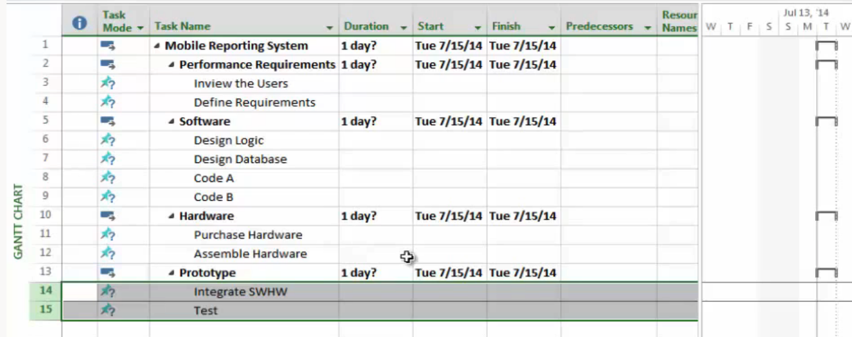
An Example: WBS
A project could be to update or replace an existing mobile system at a company. The WBS will then break down the deliverables hierarchical from general to specific so that a final list of actions, easily understood and feasible, are provided to the right people in the team. Here is an example done with Microsoft Project:

Slide 50
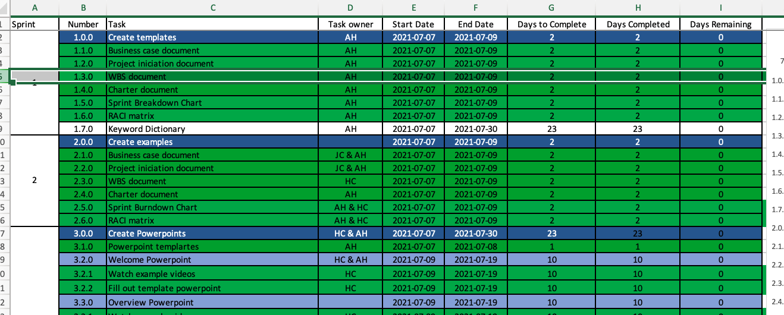
An Example WBS
Project LaCEM used the following WBS section:

Slide 51
References:
https://www.youtube.com/watch?v=akO2Lf1fHmM
https://www.youtube.com/watch?v=4SYXJpbvPfs

Slide 52
Managing a Project from A-Z
Feasibility Study
Project Risk
Project Constraints
Business Case Document
Project Initiation
Work Breakdown Structure (WBS)
Key Performance Indicators (KPIs) and Key Responsibility Areas (KRAs)
Sprint Burndown Chart
Project Charter
Sprint Burndown Chart
RACI Matrix

Slide 53
KPIs and KRAs
Projects have KPIs
Key Performance Indicators
They help to evaluate progress of the project.
Roles have KRAs
Key Responsibility Areas
They are the basic responsibilities of a person.

Slide 54
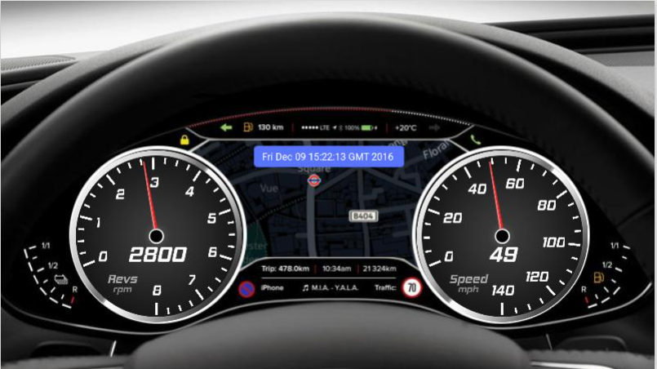
KPI = Key Performance Indicator
Are we going too slow?
Are we going in the right direction?
Is the car running properly?
Do we need to stop for gas?
KPIs are the metrics that tell you how things are going.

Slide 55
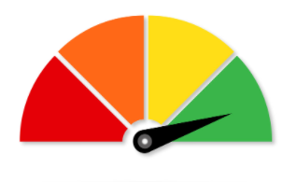
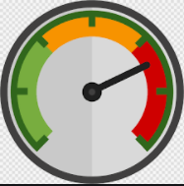
KPIs Help Answer: “Is the Team Making Progress?”
KPIs are used differently in various types of projects and teams. In the context of DSA project management, KPIs are generally measures of team performance:
Project Schedule Resource Utilization Communication

Slide 56
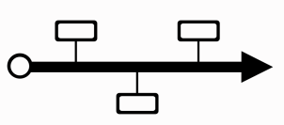
KPIs and the Project Lifecycle
KPIs are established in the early phases of the project and are key components of the Project Initiation and the Project Charter. However, KPIs are tracked regularly throughout execution of the project.
Business Case
Project Charter
Project Initiation
Sprint Burndown Chart
Initiation
Execution
Planning
Work Breakdown Structure
RACI Matrix
KPIs are tracked regularly.

Slide 57
Writing Effective KPIs
Create SMART KPIs:
Specific
Measurable
Achievable
Realistic
Timebound
Develop them jointly.
Share them with all stakeholders.
Assign them to specific person or team.
Review them regularly.

Slide 58
Project LaCEM Example
COMMUNICATION
Average weekly email reply time must be less than 6 hours for the entire team.
Three 15-20min stand-up meetings must be held every week with a quorum of 75% for each meeting.
RESOURES
All team members must attend at least 80% of project meetings.
SCHEDULE
Average weekly WBS element delays must be less than 2 hours for the entire team.
Average blocker turn-over must be a maximum of 2 meeting periods per sprint.

Slide 59
KRA = Key Responsibility Area
KRAs define the job responsibility of a team member and refers to the specific areas of work for which they are responsible.
Task
KRA
Task
Task
Role
KRA
Task
KRA
Task
Task
Task

Slide 60
Why are KRAs Important?
Project Goal
Task
KRA
Task
Task
Project Goal
KRA
Task
KRA
Task
Project Goal
Task
Task
KRAs are important to align each member’s role(s) to the project goals. KRAs define and clarify expectations and lead to effective performance reviews.

Slide 61
KRAs and the Project Lifecycle
KRAs are established in the early phases of the project and are key components of the Project Charter.
Business Case
Project Charter
Project Initiation
Sprint Burndown Chart
Initiation
Execution
Planning
Work Breakdown Structure
RACI Matrix

Slide 62
Writing Effective KRAs
Create SMART KPIs:
Specific
Measurable
Achievable
Realistic
Timebound
Develop them jointly.
Share them with all stakeholders.
Assign them to specific person or team.
Make them unique to each person.
Review them regularly.

Slide 63
Project LaCEM Example
KRA
TASK
Attend all meetings, reply to all emails in 24 hrs
MWF standups, weekly team
Provide progress on performance metrics (KPIs)
Carry out all project tasks assigned by the PM
Build deliverables (PPTs)
Test Deliverables
Serve as project consultant
Develop Business Case
Project Initiation Document

Slide 64
References
8 Essential KPI Metrics for Teams - Project Management Training
(https://www.youtube.com/watch?v=Te9mYmonVjE)
Top 3 KPIs for Project Managers
(https://www.youtube.com/watch?v=f_szFzBjfFg)
What is a good KPI – the definition of a good KPI
(https://www.youtube.com/watch?v=SEkT2t-pAbg)
How to Develop Key Performance Indicators.mp4
(https://www.youtube.com/watch?v=2tuWjtc2Ifk)
KRA vs KPI Difference Explained​
https://www.youtube.com/watch?v=nZ_mojJbmeI​
​
KRA setting | Goal Setting with sample formats | Balanced Scorecard​
https://www.youtube.com/watch?v=tGtOQNsxmFc​
​
Project Reporting​
https://www.projectmanagement-training.net/3-project-reporting/​
​
Defining the Decision Points​
https://pmhut.com/defining-the-decision-points-milestones

Slide 65
What are KDPs?
Key Decision Points
Projects have KDPs
KDPs are the events at which the decision authority determines the readiness of a project to progress to the next phase of the life cycle or identifies other changes that need to be made in such areas as resources, funding, or staffing.

Slide 66
KDPs and the Project Lifecycle
KDPs are established in the early phases of the project and are key components of the Project Charter. They occur at the end of each sprint or phase.
Business Case
Project Charter
Project Initiation
Sprint Burndown Chart
Initiation
Execution
Planning
Work Breakdown Structure
RACI Matrix

Slide 67
Why are KDPs Important?
KDPs provide the opportunity to reconsider important elements of the project such as scope, budget, risks, constraints and the project phases that are yet to come.
Terminate?
Terminate?
Terminate?
Initiation
Execution
Proceed?
Proceed?
Proceed?
Re-plan?
Revise?
Update?
Planning
On Hold?
On Hold?
On Hold?

Slide 68
Project LaCEM Example

Slide 69
Managing a Project from A-Z
Feasibility Study
Project Risk
Project Constraints
Business Case Document
Project Initiation
Work Breakdown Structure (WBS)
Key Performance Indicators (KPIs) and Key Responsibility Areas (KRAs)
Sprint Burndown Chart
Project Charter
Sprint Burndown Chart
RACI Matrix

Slide 70
What is a Project Charter?
A document that outlines the most important information about a project.
Sets the formal authorization to begin planning.
A high-level overview that is quick and easy-to-read but not detailed.

Slide 71
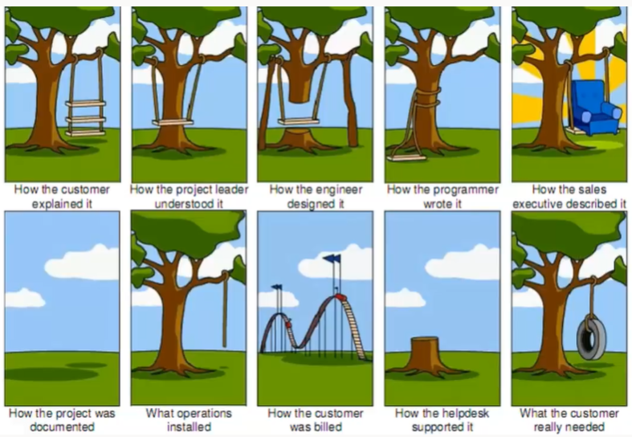
Why is a Project Charter important?

Slide 72
In Other Words….
*A project charter aligns everyone’s thinking and ensures agreement on all aspects of the project.

Slide 73
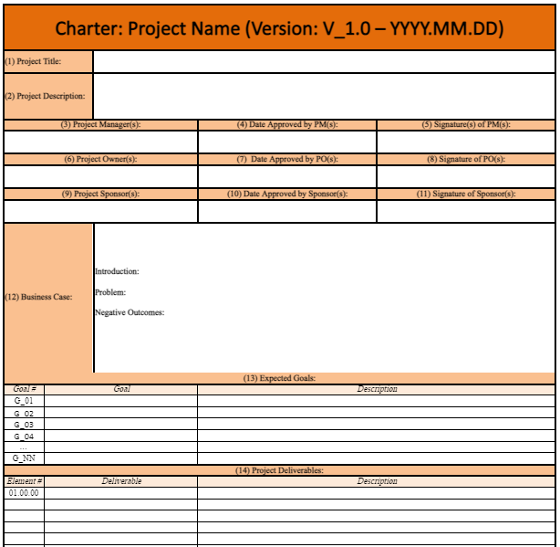
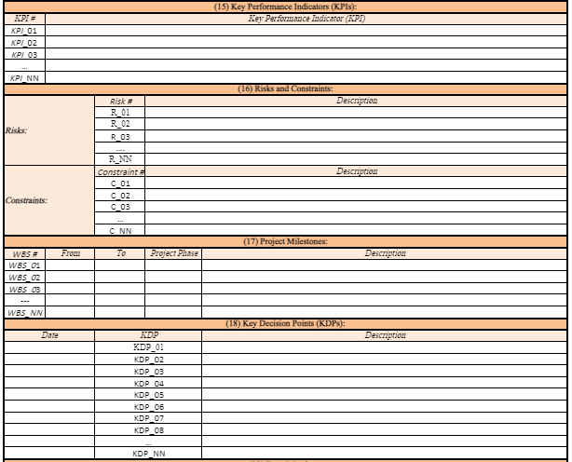
Sections
Project Description: The 60,000-Meter view of the project.
Business Case: The business/research need that will be addressed, the high-level problems that will be solved.
Expected Goals: The main goals that will be addressed by the completion of the project.
Project Deliverables: The final outcomes, the list of products or services the sponsor will receive.
Key Performance Indicators (KPIs): How you will know that you are making progress.
Risks and Constraints: Risks can directly affect the project budget and/or timeline and result in total failure. Constraints are avoidable bottlenecks that will not result in total failure but can directly affect the project budget and/or timeline.
Project Milestones: Events that mark the end of each key phase/sprint.
Key Decision Points (KDPs): Decisions made at the end of the key phases/sprints.
Team Members and Key Responsibility Areas (KRAs): Team members other than the sponsor(s).

Slide 74
The Project Charter and the Project Lifecycle
Business Case
Project Charter
Project Initiation
Initiation
Execution
Planning
Work Breakdown Structure
RACI Matrix

Slide 75
An Example Charter:
Notes:
This example charter is available in your professional lab Google templates and examples folder.

Slide 76
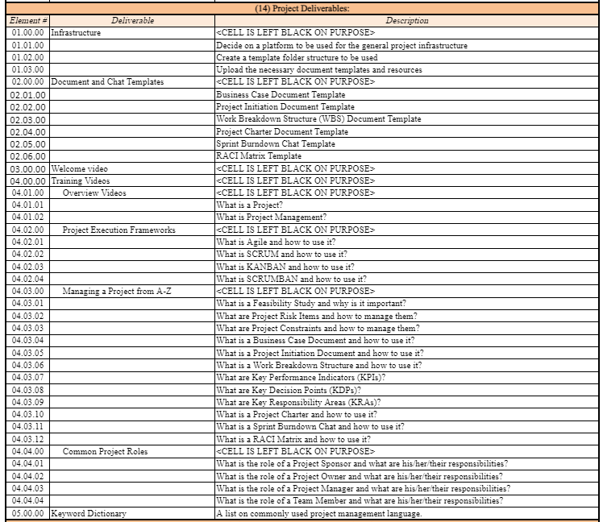
An Example Charter (con’t):

Slide 77
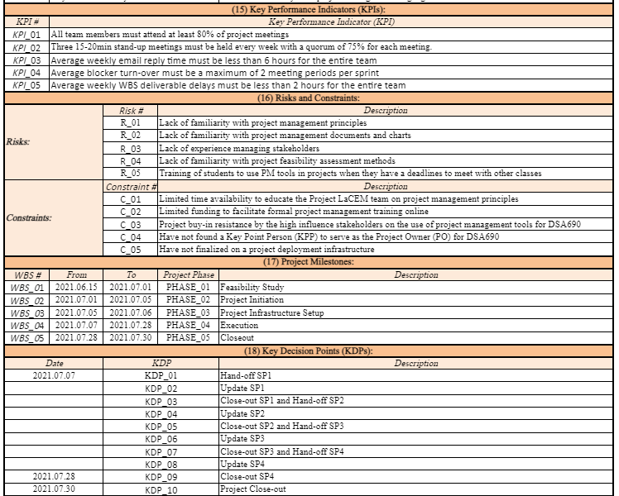
An Example Charter (con’t):

Slide 78
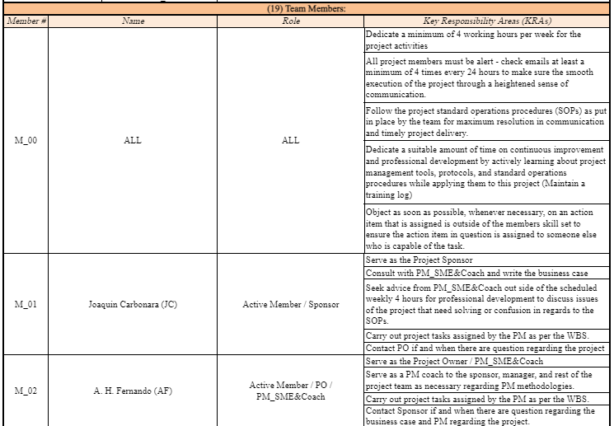
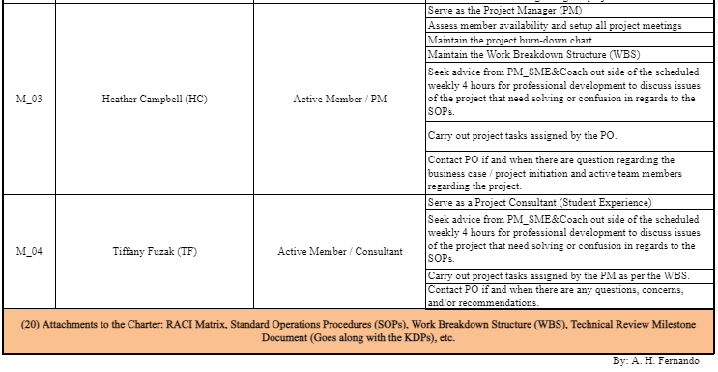
An Example Charter (con’t):

Slide 79
References
How To Create a Project Charter.mp4
(https://www.youtube.com/watch?v=43dZqT5H3BM)
How to Write a Project Management Charter
(https://www.youtube.com/watch?v=I4JsU42IO6g)

Slide 80
Managing a Project from A-Z
Feasibility Study
Project Risk
Project Constraints
Business Case Document
Project Initiation
Work Breakdown Structure (WBS)
Key Performance Indicators (KPIs) and Key Responsibility Areas (KRAs)
Sprint Burndown Chart
Project Charter
Sprint Burndown Chart
RACI Matrix

Slide 81
Sprint Burndown Charts
A Sprint Burndown Chart shows the rate at which work is completed and tracks progress towards the Sprint Goal in terms of how much work remains.

Slide 82
Makes the work of a team visible.
Plans and tracks the progress of Sprints.
Allows team members to see work remaining and time remaining.
Helps team members to see progress at-a-glance so adjustments can be made earlier to stay on track.
Why is a Sprint Burndown Chart Important?

Slide 83
How is a Sprint Burndown Chart created?
X-Axis
The x-axis indicates the milestones – usually days.
Y-Axis
The y-axis represents the remaining work to be done in a sprint (# of tasks remaining).
Progress Line
This line indicates how the team is progressing in real-time and offers an estimated timeframe for the remaining work.
Guideline (optional)
This is a diagonal line drawn from top left to bottom right. If all tasks are completed at a steady pace and on-time, the progress line will look like the guideline.

Slide 84
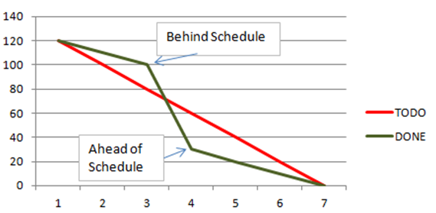
Sprint Burndown Chart
# of Tasks
# of Weeks

Slide 85
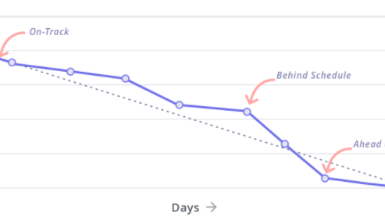
How to Read a Burndown Chart
Compare the progress line to the guideline. The closer the two lines are, the better your chances are of completing the tasks by the deadline.

Slide 86
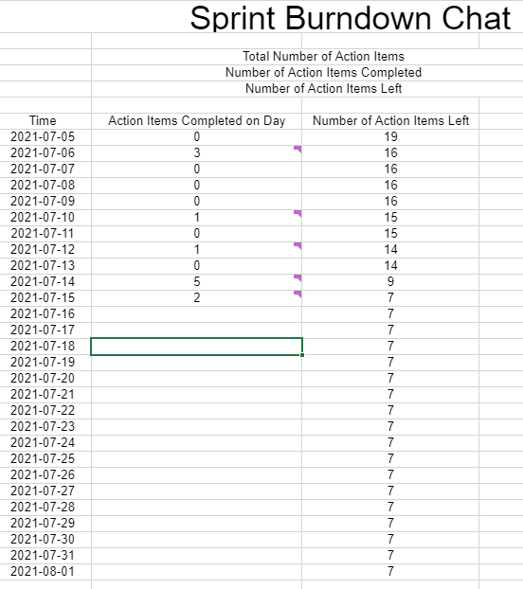
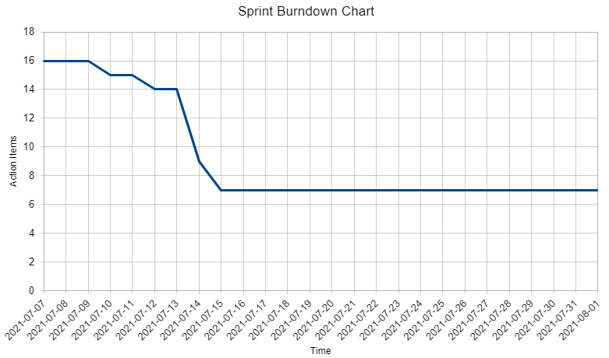
An Example: Project LaCEM Burndown Chart

Slide 87
References:
Burn up and burn down charts
(https://www.youtube.com/watch?v=WfWBxSwqqpU)
How to Create a Sprint Burndown Chart in Excel
(https://www.youtube.com/watch?v=J17dOgmjS2c)

Slide 88
Managing a Project from A-Z
Feasibility Study
Project Risk
Project Constraints
Business Case Document
Project Initiation
Work Breakdown Structure (WBS)
Key Performance Indicators (KPIs) and Key Responsibility Areas (KRAs)
Project Charter
Sprint Burndown Chart
RACI Matrix

Slide 89
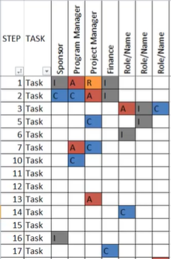
What is a RACI Matrix?
Responsibility Assignment Matrix
A chart that maps Roles to Tasks, assigning each stakeholder one of the following designations:
R = Responsible
A = Accountable
C = Consulted
I = Informed

Slide 90
RACI Explained
Responsible – Those who do the work of the task.
Accountable – Those who sign-off or approve when a task is complete.
Consulted – Those whose input is used to complete the task.
Informed – Those who are informed about the status of the task.

Slide 91
Why is a RACI Matrix Important?
It is a simple and effective way to assign and document roles and responsibilities.
It maintains clear expectations and understanding of roles.
It helps to avoid the blame game.
It helps identify gaps and/or an uneven distribution of assignments.
It exposes problems before they affect the project.

Slide 92
Tips for an Effective RACI Matrix
Create the Matrix jointly, with collaboration from team members and stakeholders.
Only one A assigned to a task.
At least one R assigned to each task.
The A for all tasks should not be the same person.
Reduce the number of Rs, Cs and Is as much as possible.
One individual can have multiple roles for a given task.
Share final chart with all stakeholders.

Slide 93
The RACI Matrix and the Project Lifecycle
Business Case
Project Charter
Project Initiation
Sprint Burndown Chart
Initiation
Execution
Planning
Work Breakdown Structure
RACI Matrix

Slide 94
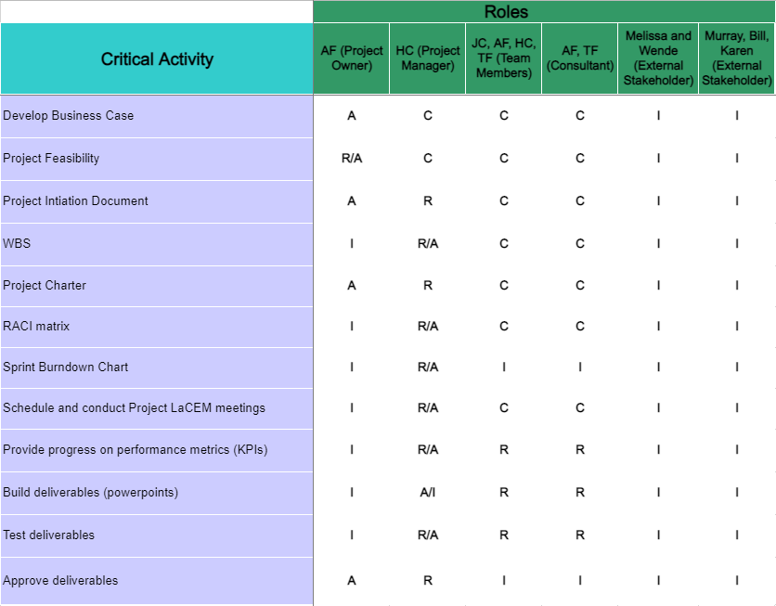
An Example:

Slide 95
References:
RACI explained its simple yet powerful
(https://www.youtube.com/watch?v=1U2gngDxFkc)
RACI Matrix
(https://www.youtube.com/watch?v=I50ZBiGf2F4)
What is a RACI Matrix?
(https://www.youtube.com/watch?v=TMT_WPFh6RU)

